Slide 1
Machine Learning for Economics: An Introduction
Susan Athey (Stanford GSB)

Slide 2
Two Types of Machine Learning
Supervised
unsupervised
Independent observations
Stable environment
Regression/prediction:
E[Y|X=x]
Classification
Pr(Y=y|X=x)
Collections of units characterized by features
Images
Documents
Individual internet activity history
Find groups of similar items

Slide 3







Classification
Advances in ML dramatically improve quality of image classification

Slide 4
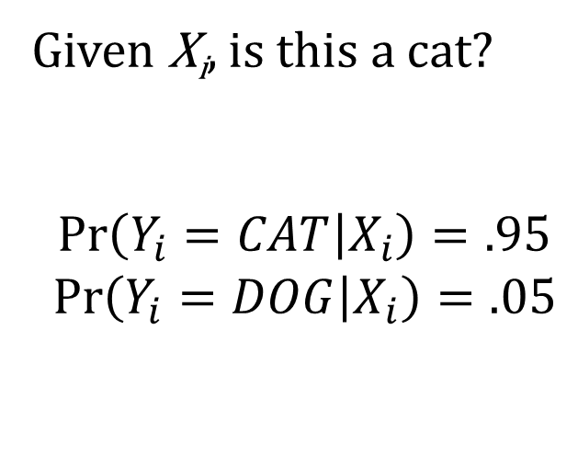
Classification
X_{i}
Neural nets figure out what features of image are important
Features can be used to classify images
Relies on stability
Given X_{i}, is this a cat?
$$\operatorname{Pr}\left(Y_{i}=CAT | X_{i}\right)=.95$$
$$\operatorname{Pr}\left(Y_{i}=DOG | X_{i}\right)=.05$$

Slide 5
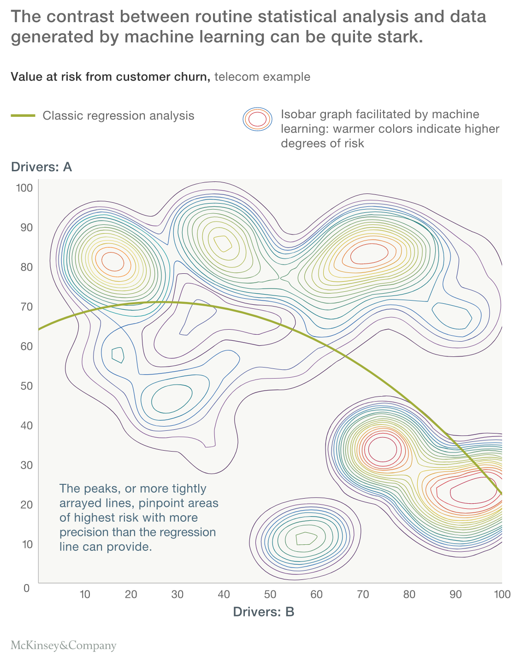
What’s New About ML?
Flexible, rich, data-driven models
Increase in personalization and precision
Methods to avoid over-fitting

Slide 6
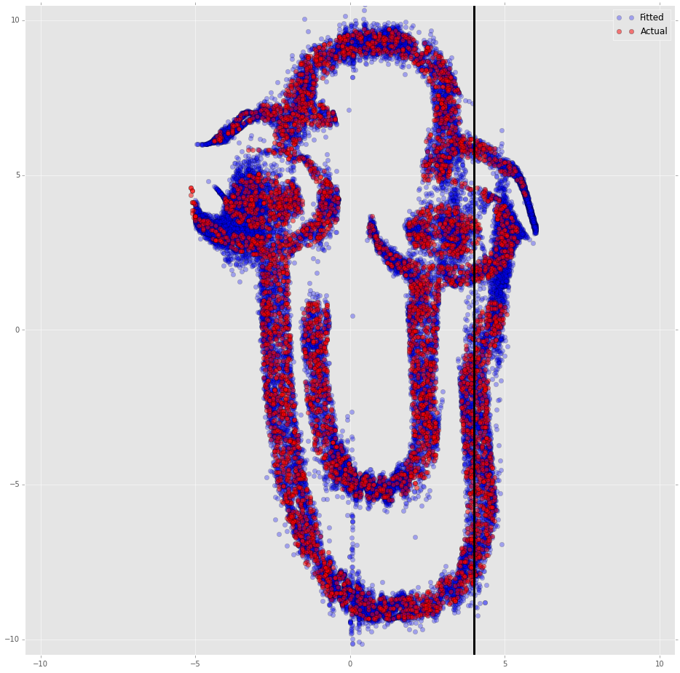
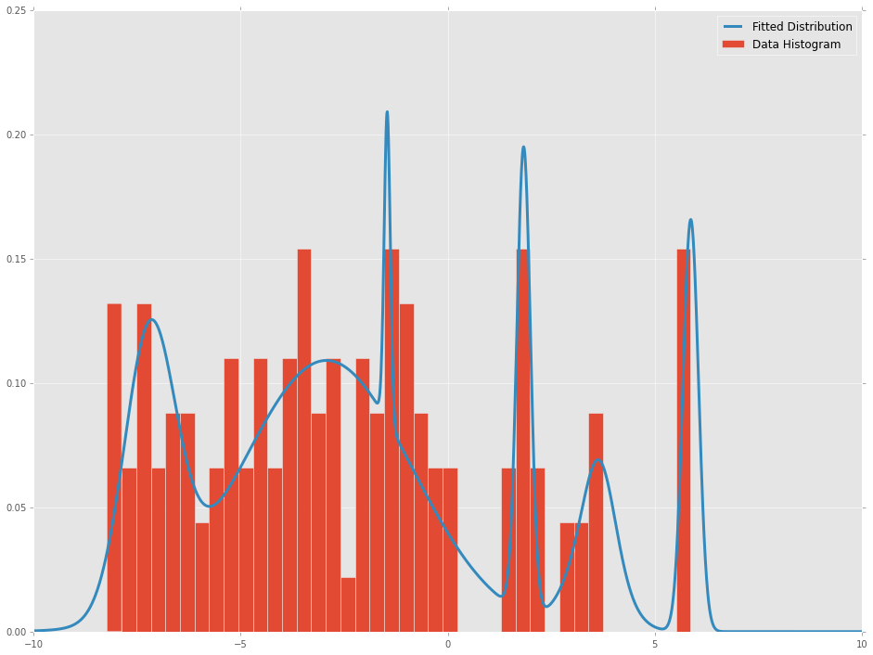
Ability to Fit Complex Shapes

Slide 7
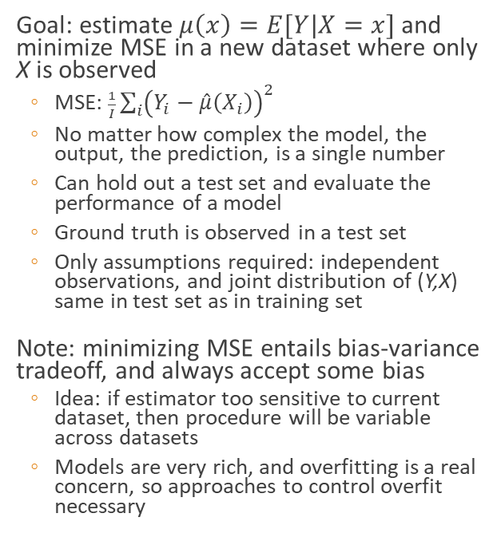
Prediction in a Stable Environment
Goal: estimate $μ\left(x\right)=E[Y|X=x]$ and minimize MSE in a new dataset where only X is observed
MSE: $\frac{1}{I}\sum_{i}{{\left(Y_{i}−\hat{μ}\left(X_{i}\right)\right)}^{2}}$
No matter how complex the model, the output, the prediction, is a single number
Can hold out a test set and evaluate the performance of a model
Ground truth is observed in a test set
Only assumptions required: independent observations, and joint distribution of (Y,X) same in test set as in training set
Note: minimizing MSE entails bias-variance tradeoff, and always accept some bias
Idea: if estimator too sensitive to current dataset, then procedure will be variable across datasets
Models are very rich, and overfitting is a real concern, so approaches to control overfit necessary
Idea of ML algorithms
Consider a family of models
Use the data to select among the models or choose tuning parameters
Common approach: cross-validation
Break data into 10 folds
Estimate on 9/10 of data, estimate MSE on last tenth, for each of a grid of tuning parameters
Choose the parameters that minimize MSE
ML works well because you can accurately evaluate performance without add’l assumptions
Your robotic research assistant then tests many models to see what performs best

Slide 8
What We Say v. What We Do (ML)
What we say
ML = Data Science, statistics
Is there anything else?
Use language of answering questions or solving problems, e.g. advertising allocation, salesperson prioritization
Aesthetic: human analyst does not have to make any choices
All that matters is prediction
What we do
Use predictive models and ignore other considerations
E.g. Causality, equilibrium or feedback effects
Wonder/worry about interpretability/reliability/robustness/ adaptability, but have little way to ask algos to optimize for it

Slide 9
Contrast with Traditional Econometrics
Economists have focused on the case with substantially more observations than covariates (N>>P)
In-sample MSE is a good approximation to out-of-sample MSE
OLS is BLUE, and if overfitting is not a problem, then no need to incur bias
OLS uses all the data and minimizes in-sample MSE
OLS obviously fails due to overfitting when P~N and fails entirely when P>N
ML methods generally work when P>N
Economists worry about estimating causal effects and identification
Causal effects
Counterfactual predictions
Separating correlation from causality
Standard errors
Structural models incorporating behavioral assns
Identification problems can not be evaluated using a hold-out set
If joint dist’n of observable same in training and test, will get the same results in both
Causal methods sacrifice goodness-of-fit to focus only on variation in data that identifies parameters of interest

Slide 10
What We Say v. What We Do (Econometrics)
What We Say
Causal inference and counterfactuals
God gave us the model
We report estimated causal effects and appropriate standard errors
Plus a few additional specifications for robustness
What we do
Run OLS or IV regressions
Try a lot of functional forms
Report standard errors as if we ran only one model
Have research assistants run hundreds of regressions and pick a few “representative” ones
Use complex structural models
Make a lot of assumptions without a great way to test them

Slide 11
Key Lessons for Econometrics
Many problems can be decomposed into predictive and causal parts
Can use off-the-shelf ML for predictive parts
Data-driven model selection
Tailored to econometric goals
Focus on parameters of interest
Define correct criterion for model
Use data-driven model selection where performance can be evaluated
While retaining ability to do inference
ML-Inspired Approaches for Robustness
Validation
ML always has a test set
Econometrics can consider alternatives
Ruiz, Athey and Blei (2017) evaluate on days with unusual prices
Athey, Blei, Donnelly and Ruiz (2017) evaluate change in purchases before and after price changes
Tech firm applications have many A/B tests and algorithm changes
Other computational approaches for structural models
Stochastic gradient descent
Variational Inference (Bayesian models)
See Sendhil Mullainathan et al (JEP, AER) for key lessons about prediction in economics
See also Athey (Science, 2017)

Slide 12
Empirical Economics in Five Years: My Predictions
Regularization/data-driven model selection will be the standard for economic models
Prediction problems better appreciated
Measurement using ML techniques an important subfield
Textual analysis standard (already many examples)
Models will explicitly distinguish causal parts and predictive parts
Reduced emphasis on sampling variation
Model robustness emphasized on equal footing with standard errors
Models with lots of latent variables

